Slide 1
JETSON INTERNET OF THINGS
PREPARED BY: Center for Artificial Intelligence and Robotics
Universiti Teknologi Malaysia
Copyright for Center for Artificial Intelligence and Robotics, UTM

Slide 2
PROGRAM OUTLINE
No | Time | Activity
1 | 09.00 – 10.00 | Introduction to Internet of Things (IoT)
2 | 10.00 – 10.30 | ESP32 micro-controller
3 | 10.30 – 11.30 | Data collection, storage, visualization and communication
4 | 11.30 – 12.30 | Project Setup
5 | 12.30 – 13.00 | Custom IoT Dashboard
6 | 13.00 – 14.00 | Lunch break
7 | 14.00 – 14.30 | YOLOv8
8 | 14.30 – 17.00 | End-of-Day Practical Assessment

Slide 3
Introduction to
Internet of Things (IoT)

Slide 4
Introduction to IoT
Internet of Things (IoT):
IoT refers to a network of physical devices connected to the internet, enabling them to collect, share, and act on data.
Key Features:
Connectivity: Devices like sensors, cameras, and appliances communicate through the internet.
Data Collection: Sensors monitor parameters like temperature, humidity, or motion.
Automation: IoT systems can trigger actions based on collected data (e.g., turning on a light when it gets dark).
Examples:
Smart home systems (e.g., smart lights, thermostats).
Industrial automation (e.g., predictive maintenance).

Slide 5
Introduction to AIoT
Artificial Intelligence of Things (AIoT):
AIoT combines IoT with artificial intelligence (AI) to make IoT systems smarter and more efficient.
Key Features:
Data Analysis: AI processes and analyzes IoT data in real-time.
Intelligence: Enables predictive insights, anomaly detection, and decision-making.
Automation at Scale: Systems can learn and improve from data over time.
Examples:
Smart assistants (e.g., Alexa predicting user preferences).
Autonomous vehicles (AI-driven IoT sensors for navigation).

Slide 6
ESP32 Micro-controller

Slide 7
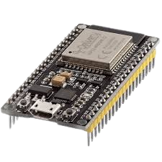
What is ESP32?
A low-cost, low-power microcontroller with built-in Wi-Fi and Bluetooth capabilities.
Developed by Espressif Systems.
Ideal for IoT applications, home automation, and embedded systems.
Key Features
Processor | Dual-Core Processor
Memory | RAM: 520 KB SRAM Flash: Typically 4MB
Wireless Connectivity | Wi-Fi Bluetooth
I/O Pins | Multiple GPIOs, ADCs, DACs, UARTs, SPIs, and I2Cs PWM for motor and LED control.

Slide 8
Data Collection, Storage, Visualization and Communication

Slide 9
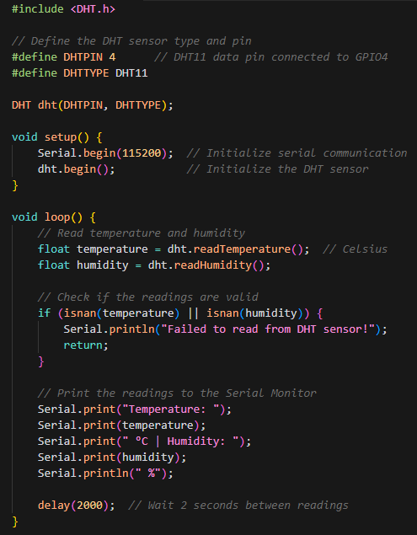
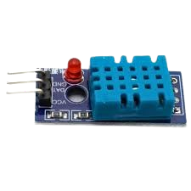
Data Collection
DHT11 - Temperature and Humidity Sensor
Overview
A basic, low-cost digital sensor for measuring temperature and humidity.
Outputs data via a single-wire protocol.
Features
Temperature Range: 0–50°C (±2°C accuracy).
Humidity Range: 20–90% RH (±5% accuracy).
Operating Voltage: 3.3–5V.
Compact and easy to use.
Applications
Environmental monitoring.
Weather stations.
Smart homes and greenhouses.
Pinout
VCC: Power supply (3.3–5V).
GND: Ground.
Data: Digital signal output.

Slide 10
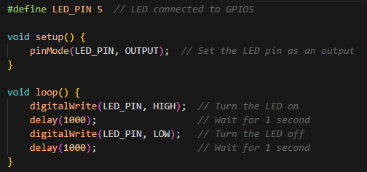
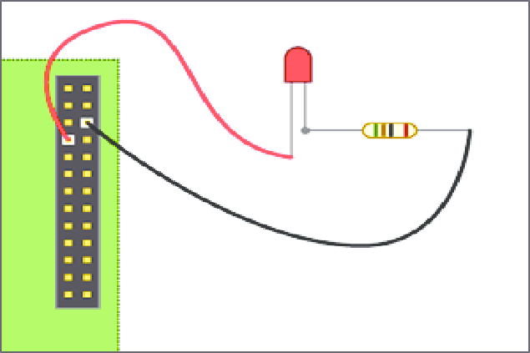
Data Collection
LED (Light Emitting Diode)
Overview
A semiconductor device that emits light when current flows through it.
Available in various colors and sizes.
Working Principle
Light is produced by the recombination of electrons and holes in the LED’s diode junction.
Features
Low Power Consumption: Operates at 2–3V typically.
Brightness: Depends on forward current (~10–20mA).
Polarity: Anode (+) and Cathode (-).
Applications
Indicators and notifications.
Status feedback in IoT devices.
Visual alerts.
Connection Example
Requires a current-limiting resistor (typically 220Ω or 330Ω) to prevent damage.
+
-

Slide 11
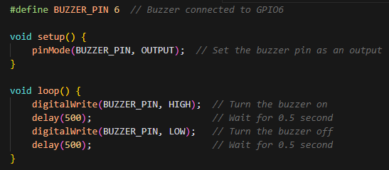
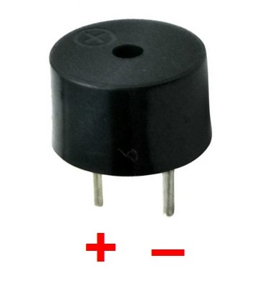
Data Collection
Buzzer
Overview
An electronic device that produces sound when an electric current flows through it.
Working Principle
Vibrates a thin membrane or uses a magnetic coil to produce sound.
Features
Voltage Range: 3–5V.
Can generate continuous or pulsed tones.
Compact and lightweight.
Applications
Alarms and notifications.
Audible feedback in IoT systems.
Critical condition alerts.
Connection Example
Connect the positive terminal to a GPIO pin and the negative terminal to GND.

Slide 12
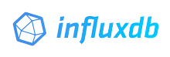
Data Storage
Overview:
InfluxDB is a time-series database optimized for storing and retrieving data over time.
Features:
High Performance: Handles millions of writes per second, suitable for large-scale IoT systems.
Ease of Use: Simple to set up with support for HTTP POST requests and client libraries.
Scalable Storage: Efficient use of storage with compression and retention policies.
Rich Ecosystem: Compatibility with tools like Grafana, Telegraf, and Kapacitor.
Use Cases of InfluxDB in IoT:
Environmental Monitoring: Track temperature, humidity, air quality, and other environmental parameters over time.
Predictive Maintenance: Monitor industrial equipment for early detection of failures based on time-series trends.
Smart Homes: Log data from devices like smart thermostats, lights, and security cameras for analysis and optimization.
Healthcare Monitoring: Collect and store patient vitals like heart rate, blood pressure, or oxygen levels for real-time monitoring.

Slide 13
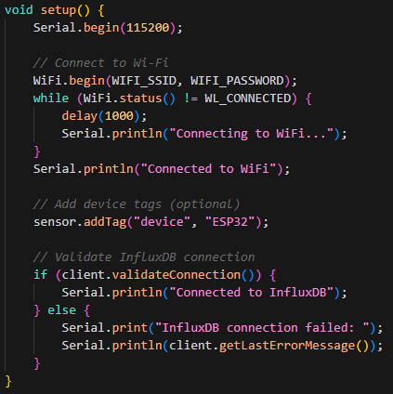
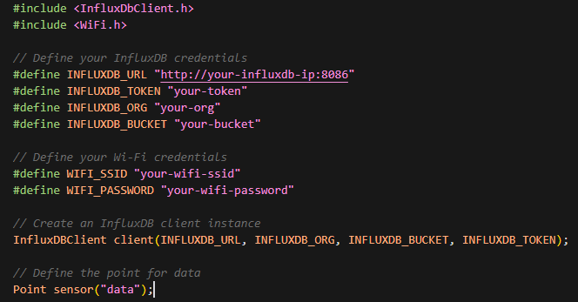
Data Storage
Initialization:
This step involves setting up the required libraries, Wi-Fi credentials, and InfluxDB client configurations.
void setup():
This function establishes a Wi-Fi connection and validates the connection to the InfluxDB server.

Slide 14
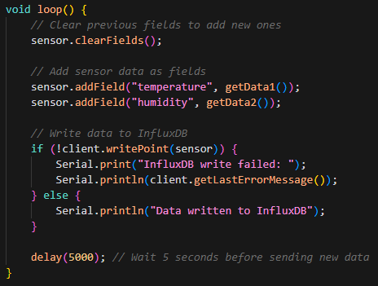
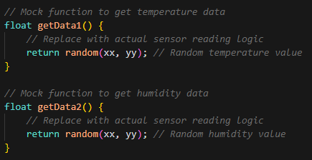
Data Storage
getData():
These helper functions simulate or retrieve actual sensor data (e.g., from a DHT11). Each function is designed to return a float value representing a specific measurement (e.g., temperature or humidity).
void loop():
This function runs continuously after setup. It collects data, sends it to InfluxDB, and logs the results.

Slide 15

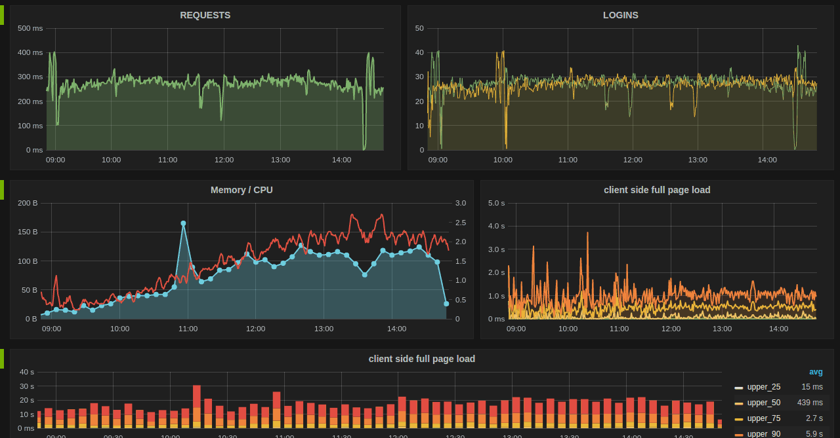
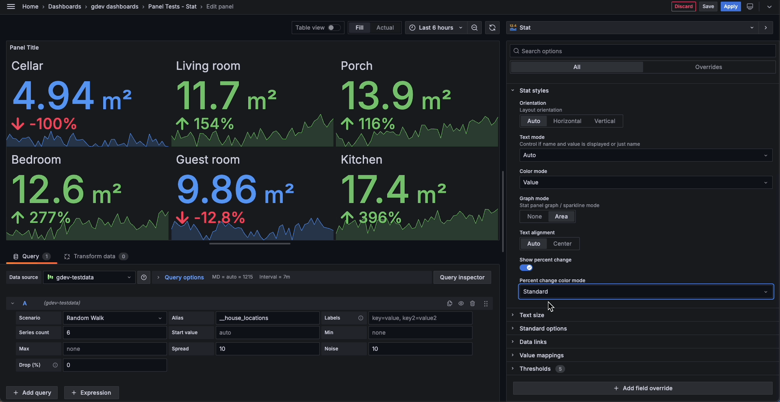
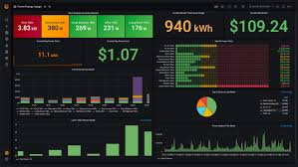
Data Visualization
Grafana is a powerful visualization tool used to create real-time dashboards for monitoring data.
Features:
Customizable panels to display data from InfluxDB or other data sources.
Alerts and notifications based on data thresholds.
Multi-platform support for monitoring from any device.
Use Case: Visualize trends in temperature and humidity data stored in InfluxDB.

Slide 16

Data Communication
Mosquitto is a popular open-source message broker that implements the lightweight MQTT protocol, making it ideal for Internet of Things (IoT) and machine-to-machine (M2M) communication.
It enables low-power devices to exchange messages efficiently using a publish–subscribe model.
Mosquitto acts as a central hub, receiving messages from publishers and delivering them to subscribed clients across platforms ranging from embedded devices to servers.
Key Features & Uses:
Lightweight Protocol (MQTT): Optimized for low bandwidth and constrained devices such as sensors and mobile systems.
Publish/Subscribe Model: Devices publish data to topics, while subscribers receive relevant messages in real time.
Open Source: Free to use, community-supported, and backed by the Eclipse Foundation.
Versatile & Compatible: Runs on Windows, Linux, and embedded systems; supports MQTT v5, v3.1.1, and v3.1.
Client Tools: Includes mosquitto_pub and mosquitto_sub for testing and basic message exchange.

Slide 17
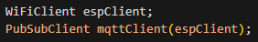
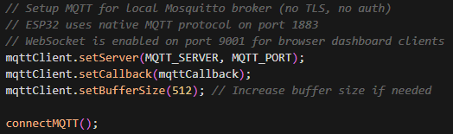
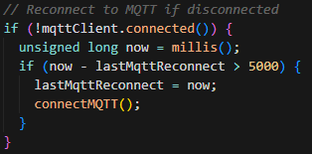
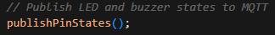
Provides TCP/IP network connection for ESP32
MQTT runs over TCP/IP, so this handles the network layer
Handles MQTT protocol (connect, publish, subscribe, callbacks)
Creates a WiFi client object for TCP/IP communication
Creates the MQTT client, passing the WiFi client for network transport
void setup {
}
Sets the MQTT broker address and port
Registers the callback for incoming messages
Sets message buffer size
Connects to the broker and subscribes to control topics
void loop {
}
Reconnection logic — If disconnected, attempts reconnect every 5 seconds
Processes incoming messages and maintains connection
Call helper functions

Slide 18
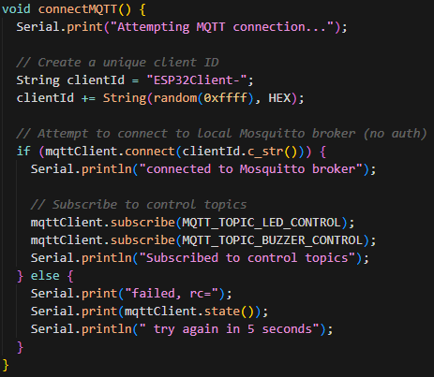
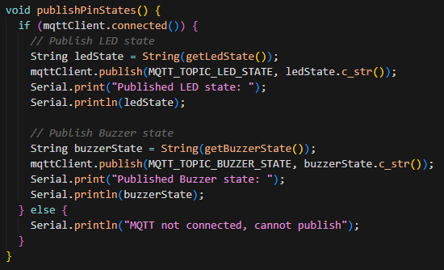
Generates a unique client ID with random suffix
Connects to the MQTT broker
Subscribes to LED and buzzer control topics
Prints connection status/errors
Checks if MQTT is connected
Reads current LED state and publishes to LED state topic
Reads current buzzer state and publishes to buzzer state topic
Prints published values to Serial
Handles case when MQTT is not connected

Slide 19
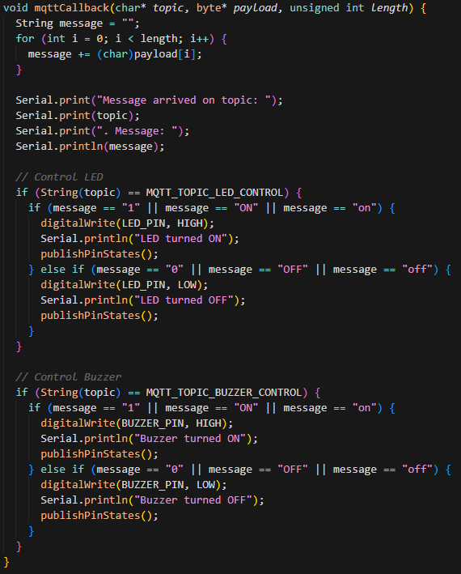
Called when a message arrives on a subscribed topic
Parses the message payload
Controls LED based on LED control topic messages ("1"/"ON"/"on" = HIGH, "0"/"OFF"/"off" = LOW)
Controls buzzer based on buzzer control topic messages (same logic)
Publishes updated pin states after changes

Slide 20
PROJECT SETUP

Slide 21
CONNECTION
DIAGRAM

Slide 22
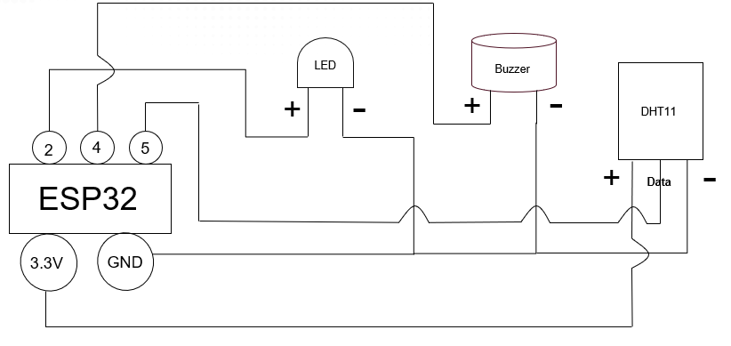

Slide 23
ESP32 Code

Slide 24
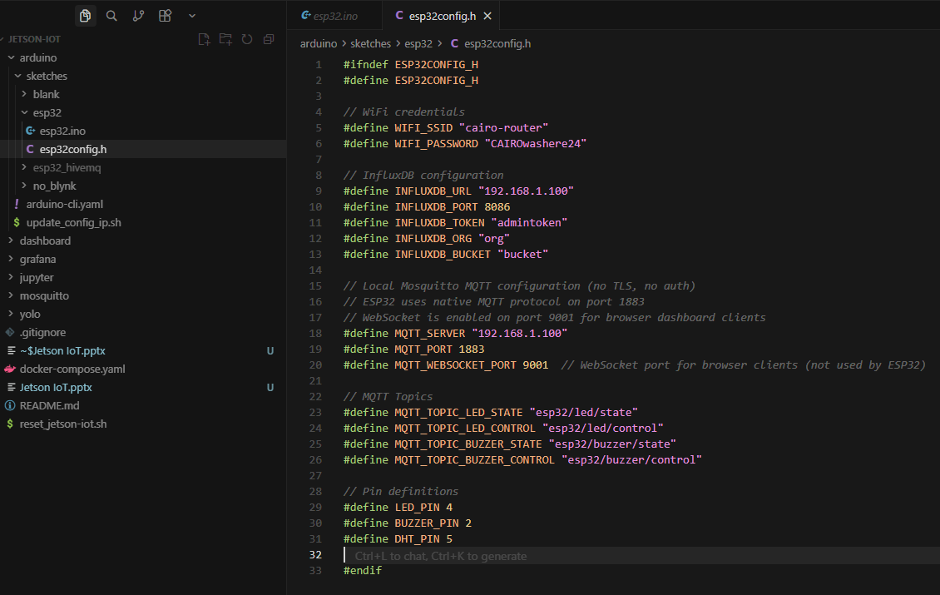
All values that needs to be changed is in esp32config.h

Slide 25
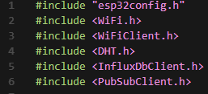
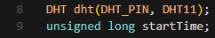
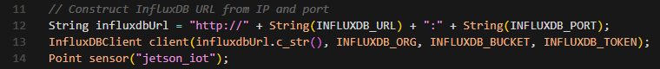
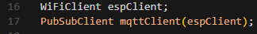
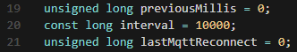
Lines 1-6: Library Includes:
Line 1: Includes custom config header with WiFi, InfluxDB, MQTT, and pin definitions
Line 2: WiFi library for ESP32 WiFi
Line 3: WiFiClient for TCP/IP connections
Line 4: DHT library for DHT11 sensor
Line 5: InfluxDB client library
Line 6: PubSubClient for MQTT
Lines 8-9: Sensor and Timing Initialization:
Line 8: Creates DHT object on pin 5 (DHT11)
Line 9: Stores program start time
Lines 11-14: InfluxDB Setup:
Line 12: Builds InfluxDB URL from IP and port
Line 13: Creates InfluxDB client with URL, org, bucket, and token
Line 14: Creates a data point named "jetson_iot"
Lines 16-17: MQTT Client Setup:
Line 16: Creates WiFiClient for TCP/IP
Line 17: Creates PubSubClient using the WiFiClient
Lines 19-21: Timing Variables:
Line 19: Tracks last sensor reading time
Line 20: Interval between readings (10 seconds)
Line 21: Tracks last MQTT reconnect attempt

Slide 26
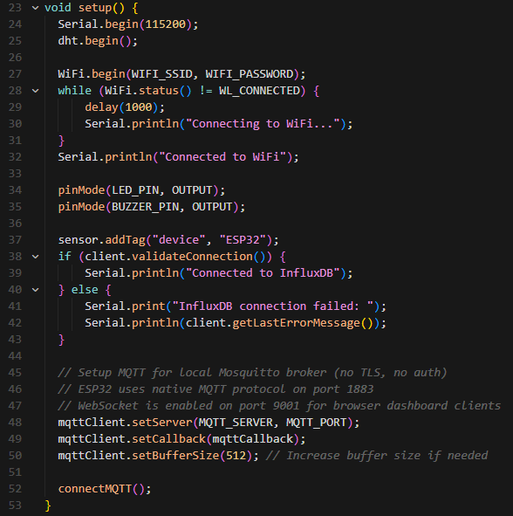
Lines 23-53: setup() Function:
Line 24: Starts Serial at 115200 baud
Line 25: Initializes DHT sensor
Lines 27-32: Connects to WiFi; waits until connected
Lines 34-35: Sets LED and buzzer pins as outputs
Line 37: Tags the InfluxDB point with device name "ESP32"
Lines 38-43: Validates InfluxDB connection and prints status
Lines 45-50: MQTT setup:
Line 48: Sets MQTT broker address and port
Line 49: Registers callback for incoming messages
Line 50: Sets message buffer size to 512 bytes
Line 52: Connects to MQTT broker

Slide 27
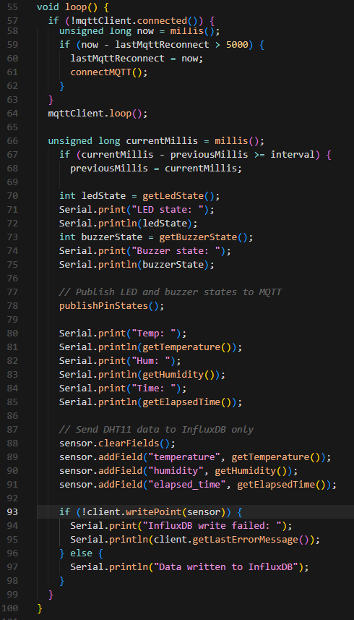
Lines 55-100: loop() Function:
Lines 57-63: MQTT reconnection
Line 64: Processes incoming MQTT messages.
Lines 66-99: Periodic sensor reading (every 10 seconds):
Lines 70-75: Reads and prints LED and buzzer states
Line 78: Publishes LED and buzzer states to MQTT
Lines 80-85: Reads and prints temperature, humidity, and elapsed time
Lines 87-91: Prepares InfluxDB data point
Lines 93-98: Writes data to InfluxDB and prints success/failure

Slide 28
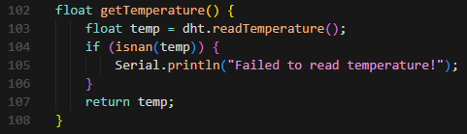
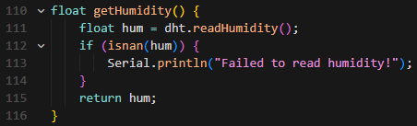
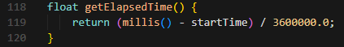
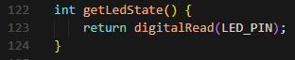
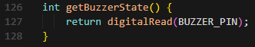
Lines 102-108: getTemperature() Function:
Reads temperature from DHT11
Returns temperature or handles read errors
Lines 110-116: getHumidity() Function:
Reads humidity from DHT11
Returns humidity or handles read errors
Lines 118-120: getElapsedTime() Function:
Calculates elapsed time since start in hours
Returns hours as float
Lines 122-124: getLedState() Function:
Reads current LED pin state (HIGH/LOW)
Returns 1 or 0
Lines 126-128: getBuzzerState() Function:
Reads current buzzer pin state (HIGH/LOW)
Returns 1 or 0

Slide 29
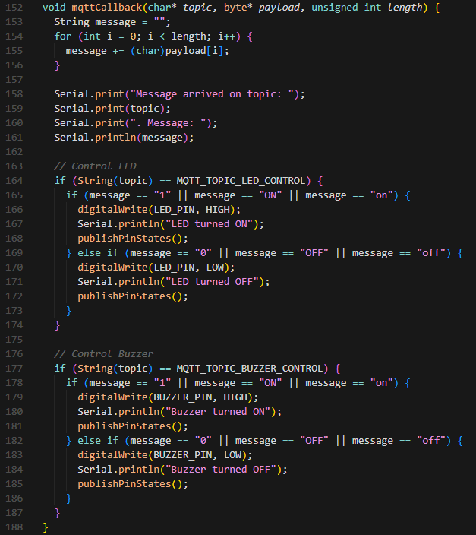
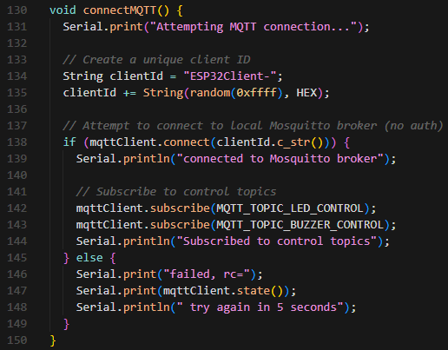
Lines 130-150: connectMQTT() Function:
Lines 131-135: Generates unique client ID with random suffix
Lines 138-144: Connects to broker
Lines 145-149: On failure, prints error code and retry message
Lines 152-188: mqttCallback() Function:
Lines 153-156: Converts byte payload to String
Lines 158-161: Prints received topic and message
Lines 164-174: LED control. Publishes updated state after change
Lines 177-187: Buzzer control. Publishes updated state after change

Slide 30
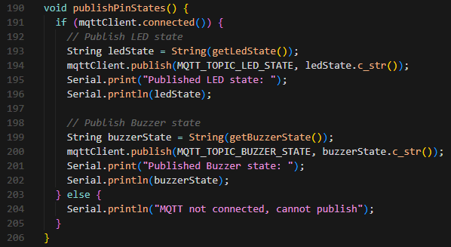
Lines 190-206: publishPinStates() Function:
Line 191: Checks if MQTT is connected
Lines 192-196: Reads LED state and publishes to LED state topic
Lines 198-202: Reads buzzer state and publishes to buzzer state topic
Lines 203-205: If not connected, prints error message

Slide 31
DOCKER

Slide 32

Overview: Docker is a platform that packages applications and their dependencies into isolated containers for consistent execution.
Why Use Docker:
Ensures consistent environments
Lightweight and fast
Simplifies deployment
Efficient resource usage
Example Usage:
Mosquitto (MQTT broker) → docker run -p 1883:1883 eclipse-mosquitto
InfluxDB (time-series database) → docker run -p 8086:8086 influxdb
Grafana (dashboard) → docker run -p 3000:3000 grafana/grafana

Slide 33
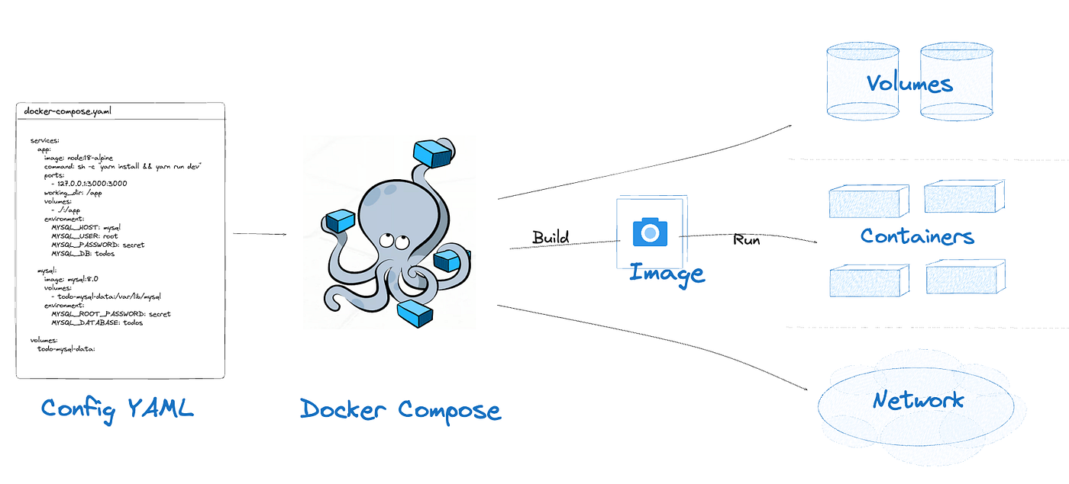
Overview: Docker Compose is a tool to define and run multi-container applications with a single configuration file (docker-compose.yml).
Usage: Run “docker-compose up –d” in the terminal from the same directory as your docker-compose.yml file.

Slide 34
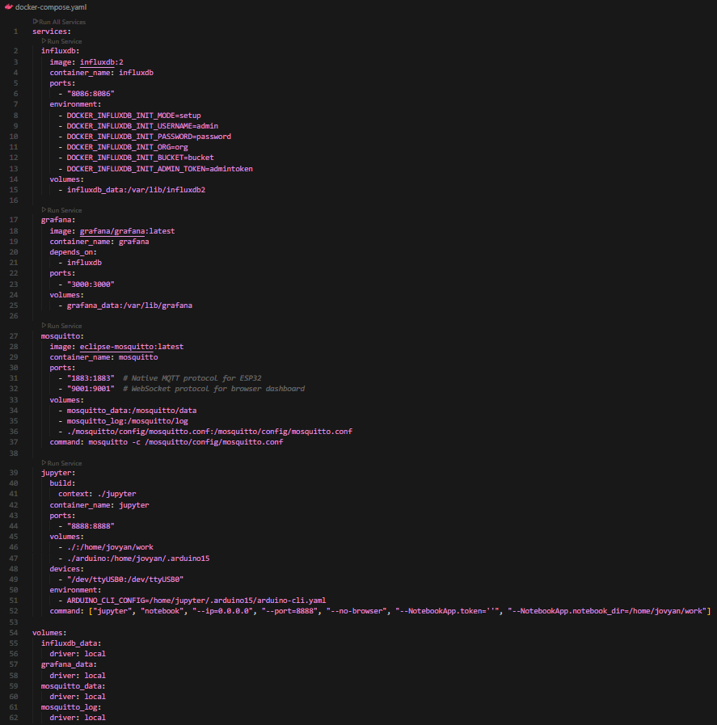

Slide 35
INFLUXDB

Slide 36
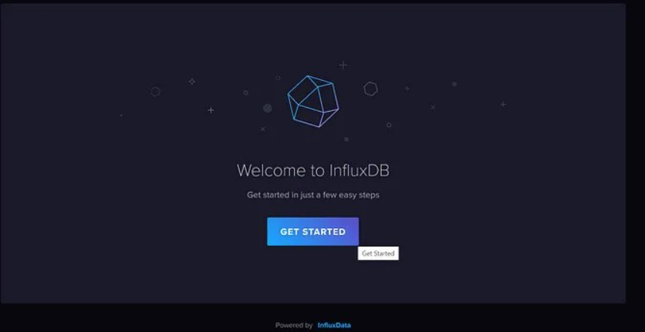
Open browser and type “http://localhost:8086”.

Slide 37
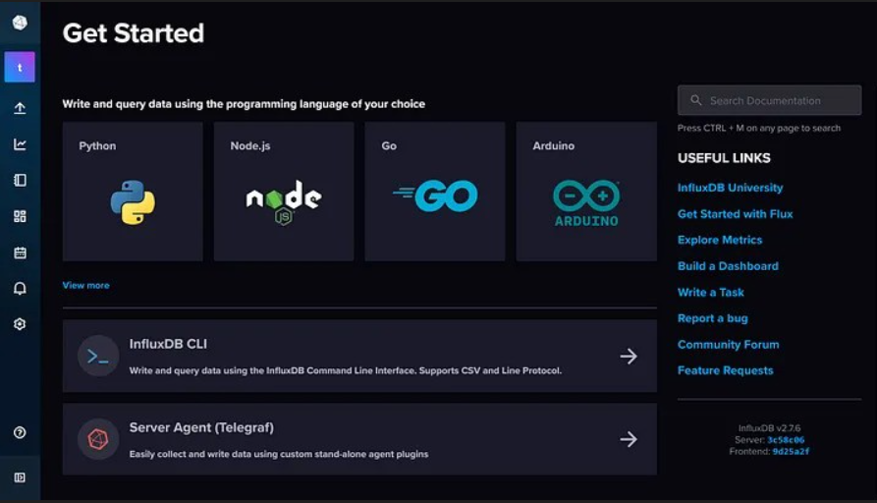
This is the home page of the Web UI.

Slide 38
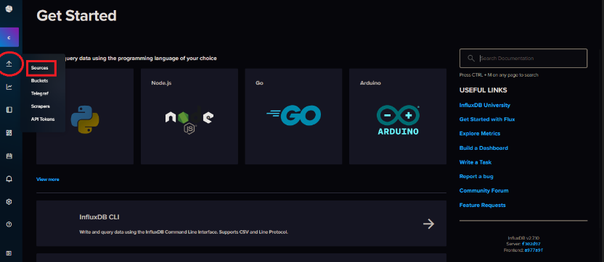
Hover the cursor to the arrow pointing upwards icon on the left side of the InfluxDB 2 Web UI and click 'Sources'.

Slide 39
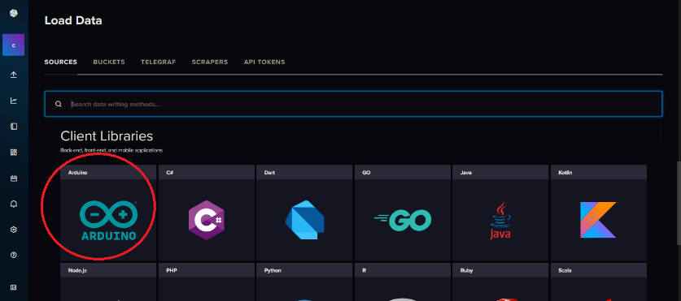
Click the Arduino logo under 'Client Libraries'.

Slide 40
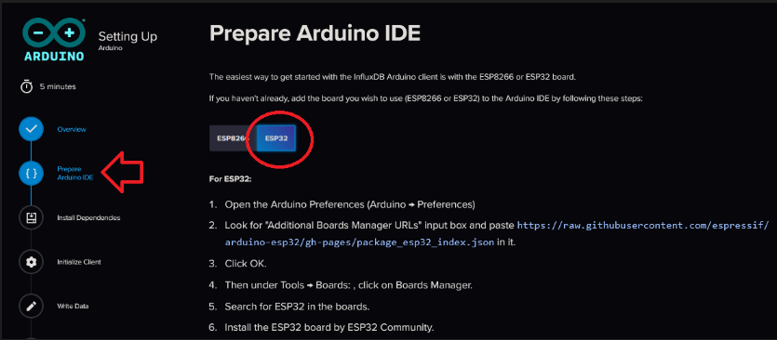
Click 'Prepare Arduino IDE' and choose 'ESP32'. Follow the instructions.

Slide 41
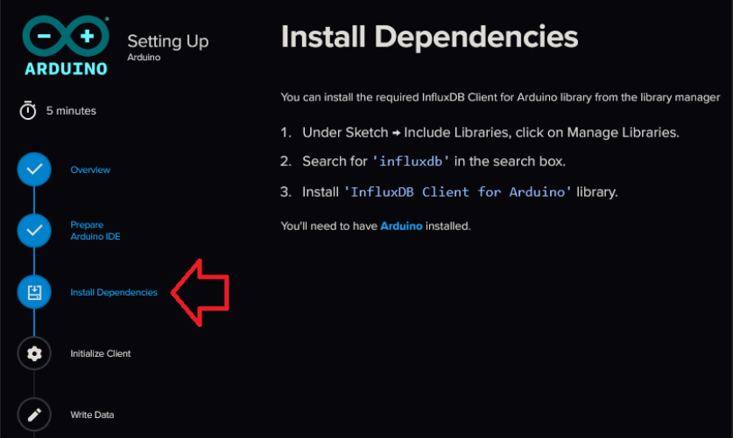
Click 'Install Dependencies' and follow the instructions.

Slide 42
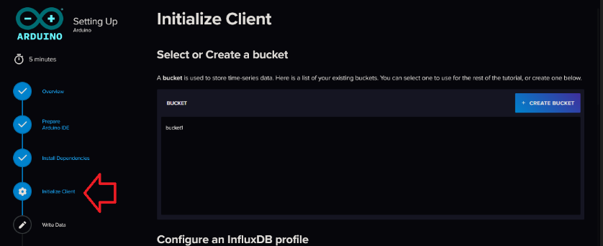
Click 'Initialize Client' to see the programming code used in Arduino IDE to initialize the InfluxDB OSS v2 client.

Slide 43
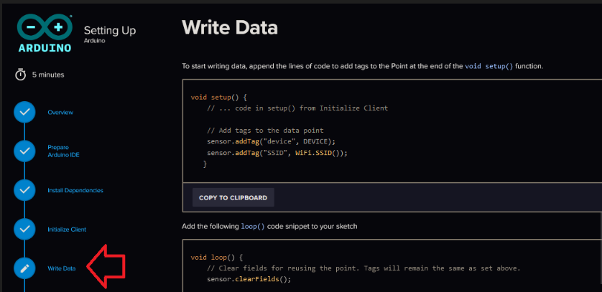
Click 'Write Data' to see how to write data into InfluxDB OSS v2 using the Arduino IDE.

Slide 44
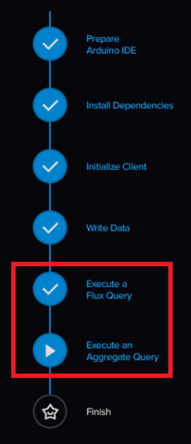
Note how to query data from InfluxDB 2 by clicking on 'Execute a Flux Query' and 'Execute an Aggregate Query'. This step will be used when setting up a panel in Grafana dashboard.

Slide 45
GRAFANA

Slide 46

Open a browser and go to http://localhost:3000
The initial username:password is admin:admin. Then, it will prompt for you to change password.

Slide 47

Open the menu by clicking on the hamburger icon on top left of the page. Click 'Connection'.

Slide 48

Search 'influxdb' in the search box and click on the InfluxDB logo.

Slide 49

Put any name for the connection.
Change 'Query Language' to 'Flux'.
Put 'http://influxdb:8086' for URL.
Toggle on 'Basic Auth' for Auth.
Enter User and Password set during setting up the InfluxDB OSS v2.
Enter the organization and bucket name set during setting up the InfluxDB OSS v2.
Copy the token and keep it somewhere safe and handy.
Hit save & test.

Slide 50

Open back the menu by clicking the hamburger icon. Click 'Dashboards'.

Slide 51

Click ‘New’ and ‘Import’.

Slide 52

Click ‘Upload dashboard JSON file. Upload ‘IoT Dashboard.json’ in “./jetson-iot/grafana/”

Slide 53

Select the datasource created before.

Slide 54

Click ‘Import’.

Slide 55

Click ‘Edit’.

Slide 56

Change bucket name. Edit the other panel.

Slide 57

Click ‘Save’ to save dashboard.

Slide 58

To add more panel, click 'Add' and 'Visualization'.

Slide 59

The time range can be adjusted as denoted by the red box. Auto-update can be set by changing the value as denoted in the blue box.

Slide 60
ARDUINO IDE

Slide 61

Go to https://www.arduino.cc/en/software/ and scroll down to look for Legacy IDE and pick Linux ARM 64 bits and click Download

Slide 62

Open terminal
cd Downloads
tar –xf arduino-1.8.19-linuxaarch64.tar.xz
cd arduino-1.8.19-linuxaarch64/
./install.sh
Go to desktop, right click on Arduino logo, click “Allow Launching”
Double-click the logo to open the app

Slide 63

IDE Interface

Slide 64


Enter: https://raw.githubusercontent.com/espressif/arduino-esp32/gh-pages/package_esp32_index.json in “Additional boards manager URLs”
Go to File > Preferences

Slide 65

Go to Tools > Manage Libraries…

Slide 66



Search “dht sensor library” and installed the one by Adafruit
Search “influxdb” and installed the one by Tobias Schurg
Search “pubsubclient” and installed the one by Nick O’Leary

Slide 67




Click button 1 to verify code syntax and wait for the bar to finish
Click button 2 and it will produce such message (refer image on the left) Once it has “Done uploading.”, you can click button 3 to monitor output

Slide 68
ARDUINO-CLI

Slide 69

Run the first and third cells to install libraries and esp32 boards.

Slide 70

Run compile after filling all the details in config.h. Then, run the upload cell.

Slide 71

Run ‘screen’ to imitate serial monitor in Arduino IDE. Cell operation can be stopped whenever. Run the next cell to kill screen. Always kill screen after.

Slide 72
Custom IoT Dashboard

Slide 73

Build a ChatGPT Prompt
Clearly define the project context:
Example: “ESP32 IoT monitoring system with DHT11 sensor, LED & Buzzer control, MQTT, InfluxDB, and Chart.js.”
Specify all technical requirements upfront:
MQTT topics, connection options, WebSocket protocol
InfluxDB version, query requirements, CSV parsing rules
Include UI/UX details:
Header, status badges, cards, toggle switches
Color scheme, fonts, layout, responsiveness
Define data handling logic:
Parsing CSV, aligning timestamps, separating fields
Updating chart & current readings in real-time
Describe JavaScript functionality clearly:
Functions for MQTT connect/publish, device state updates
Functions for InfluxDB fetch, parse, chart update
Error handling and user notifications
Provide styling requirements:
Background gradient, card design, hover effects
Toggle switches style, text formatting, spacing
Set default behaviors:
No auto-connect, default input values, initial chart empty
Status badges start as “Disconnected”
Mention libraries/CDNs to use:
Chart.js, MQTT.js, and avoid other external dependencies
Emphasize robustness and error handling:
Connection failures, invalid data, toggles revert on errors

Slide 74
YOLOv8

Slide 75



Right click create_venv.sh
Click ‘Properties’
Allow to execute file
Click ‘Run as Program’

Slide 76



Right click start.sh
Click ‘Properties’
Allow to execute file
Click ‘Run as Program’

Slide 77




Library Imports
MQTT Broker Configuration
MQTT Topic Definitions
MQTT Client Creation
MQTT Connection Callback
MQTT Message Callback
Register MQTT Callbacks

Slide 78



MQTT Connection Setup
YOLOv8 Model Loading
Class Selection

Slide 79

Video Capture Configuration
Detection State Variables
FPS Calculation Variables
Startup Messages

Slide 80

Main Detection Loop
FPS Calculation
YOLOv8 Detection
Detection Cooldown Logic
MQTT Control Logic
Frame Annotation
Display and Exit

Slide 81


Keyboard Interrupt Handler
Cleanup (finally block)

Slide 82
End-of-Day Practical Assessment

Slide 83
End-of-Day Practical Assessment
AI + Dashboard + IoT
Create a new custom IoT dashboard, esp32 sketch and YOLO python file.
Subscribe to esp32/led/control and esp32/buzzer/control.
Subscribe to esp32/led/state and esp32/buzzer/state.
Subscribe to ai/detection/status and ai/detection/confidence.
Add a toggle to control AI (ai/control).
Add a slider to set AI confidence threshold (ai/threshold).
When in AI mode, dashboard becomes read only.
Log the source of each action (AI or human) on the dashboard.
Update all information in near real-time.

Slide 84
cairo@utm.my / trainer’s email

